Slide 1

PARALLEL PROGRAMMING...
Copyright 2023 Patrick Lemoine. All rights reserved.

Slide 2

Parallel Programming: Overview
SESSION 3/6
GOAL
Programming Interface for parallel computing
OpenMP (Open Multi-Processing)

Slide 3
Programming interface for parallel computing
병렬 컴퓨팅을 위한 프로그래밍 인터페이스

Slide 4

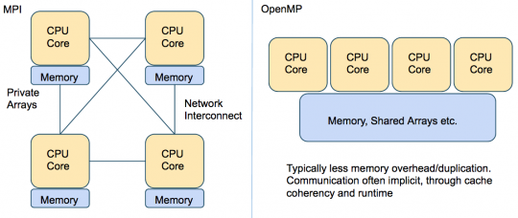
Programming interface…
Remember
.
.
MPI (Message Passing Interface) is a multi-process model whose mode of communication between the processes is explicit.
==> communication management is the responsibility of the user.
.
OpenMP (Open Multi-Processing) is a multitasking model whose mode of communication between tasks is implicit
==> communications is the responsibility of the compiler.

Slide 5



OpenMP (Open Multi-Processing)

Slide 6



OpenMP (Open Multi-Processing)
OpenMP is a programming interface for parallel computing on shared memory architecture.
The OpenMP API consists of
compiler directives (for insertion into sequential Fortran/C/C++$code)
a few library routines
some environment variables
Advantages:
User-friendly
Incremental parallelization of a serial code
Possible to have a single source code for both serial and parallelized versions
Disadvantages:
Relatively limited user control
Most suitable for parallelizing loops (data parallelism)
Performance?

Slide 7
OpenMP (Open Multi-Processing)
OpenMP is a programming interface for parallel computing on shared memory architecture.
It allows you to manage:
the creation of light processes
the sharing of work between these lightweight processes
synchronizations (explicit or implicit) between all light processes
the status of the variables (private or shared).

Slide 8
OpenMP (Open Multi-Processing)
Shared memory model
Threads communicate by accessing shared variables
The sharing is defined syntactically
Any variable that is seen by two or more threads is shared
Any variable that is seen by one thread only is private
Race conditions possible
Use synchronization to protect from conflicts
Change how data is stored to minimize the synchronization

Slide 9
OpenMP (Open Multi-Processing)
Multicore CPUs are everywhere:
Servers with over 100 cores today and more
Even smartphone CPUs have 8 cores
Multithreading, natural programming model
All processors share the same memory
Threads in a process see same address space
Many shared-memory algorithms developed
Multithreading is hard
Lots of expertise necessary
Deadlocks and race conditions
Non-deterministic behavior makes it hard to debug

Slide 10
OpenMP: Process and thread: whatis the difference ?
You need an existing process to create a thread.
Each process has at least one thread of execution.
A process has its own virtual memory space that cannot be accessed by other processes running on the same or on a different processor.
All threads created by a process share the virtual address space of that process. They read and write to the same address space in memory. They also share the same process and user ids, file descriptors, and signal handlers. However, they have their own program counter value and stack pointer, and can run independently on several processors.

Slide 11
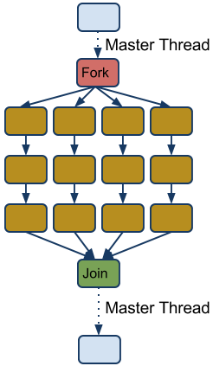
OpenMP: Terminology and behavior
OpenMP Team = Master + Worker
Parallel Region is a block of code executed by all threads simultaneously (has implicit barrier)
The master thread always has thread id 0
Parallel regions can be nested
If clause can be used to guard the parallel region

Slide 12




OpenMP: General Code Structure
#include <omp.h>
main ()
{
int var1, var2, var3;
//serial code
//start of a parallel region
#pragma omp parallel private(var1, var2) shared(var3)
{...}
//more serial code
{...}
//another parallel region
#pragma omp parallel
{…}
}

Slide 13
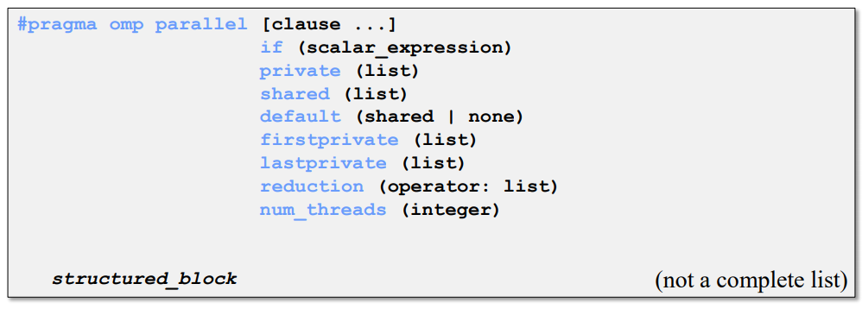
OpenMP: Constructs
Parallel region
Thread creates team, and becomes master (id 0)
All threads run code after
Barrier at end of parallel section

Slide 14
OpenMP: Parallel Clauses
Only execute in parallel.
Otherwise serial.
Data local to thread.
Value are not guaranted to be defined on exit (even if defined before)
No storage associated with original object
Use firstprivate and/or lastprivate clause to override
Variables in list are private.
Initialized with the value the variable had before entering the construct.
Only in for loops
Variables in list are private.
The thread that executes the sequentially last iteration updates the value of the variables in the list.

Slide 15
OpenMP: Parallel Clauses
Data is accessible by all threads in team.
All threads access same address space.
Improperly scoped variables are big source of OMP bugs
- Shared when should be private
- Race condition
Tip: Safest is to use default (none) and declare by hand.

Slide 16
OpenMP Barrier
When a thread reaches a barrier it only continues after all the threads in the same thread team have reached it
Each barrier must be encountered by all threads in a team, or none at all
The sequence of work-sharing regions and barrier regions encountered must be same for all threads in team
Implicit barrier at the end of: do, parallel, single, workshare

Slide 17
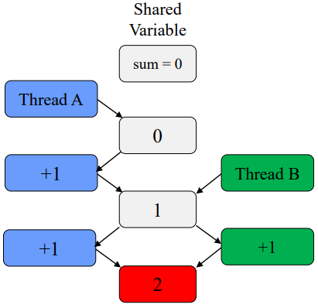
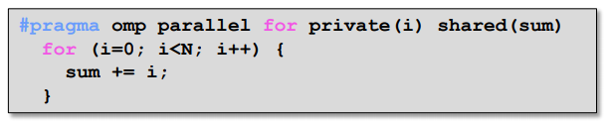
OpenMP: Caution Race Condition
When multiple threads simultaneously read/write
Multiple OMP solutions
- Reduction
- Atomic
- Critical
Should be 3!

Slide 18
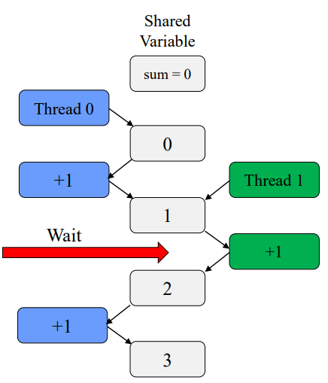
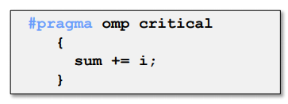
OpenMP: Critical Section
One solution: use critical
Only one tread at a time can execute a critical section
Downside ?
SLOOOOWWW
Overhead and serialization

Slide 19
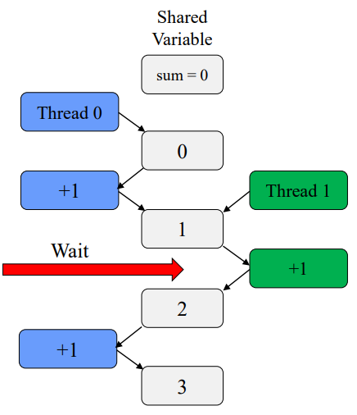
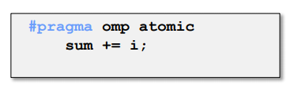
OpenMP: Atomic
Atomics like "mini" critical
Only one line
Certain limitations
Hardware controlled
Less overhead the critical

Slide 20
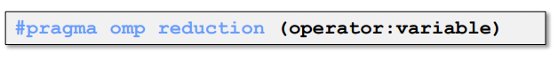
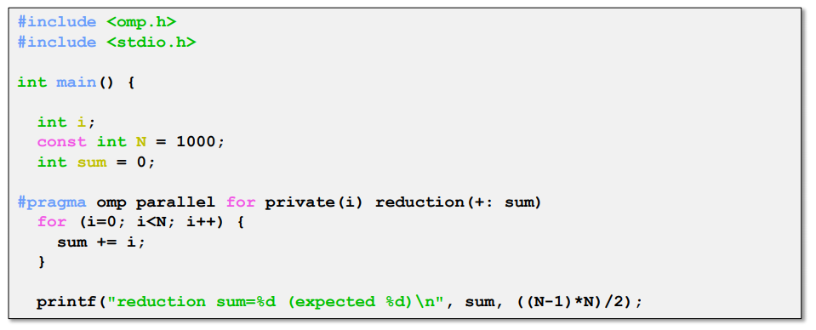
OpenMP: Reduction
Avoids race condition
Reduce variable must be shared
Makes variable private, then performs operator at end of loop
operator cannot be overloaded (c++)
One of: +,*,-,/ (and &,^,|,&&,||)
OpenMP 3.1: added min and max for c/c++

Slide 21
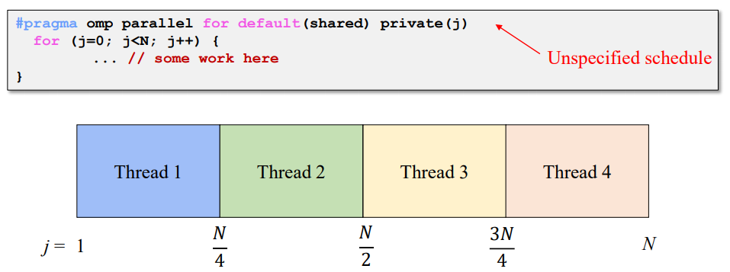
OpenMP: Scheduling omp for
How does a loop get split up ?
In MPI, we have to do it manually
If you do not tell what to do, the compiler decides
Usually compiler chooses "static" - chunks of N/p

Slide 22
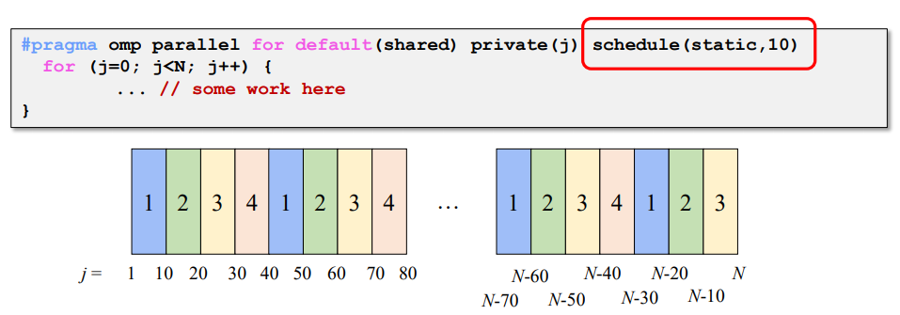
OpenMP: Static Scheduling
You can tell the compiler what size chunks to take.
Keeps assigning chunks until done.
Chunk size that is not a multiple of the loop will results in thread with uneven numbers.

Slide 23
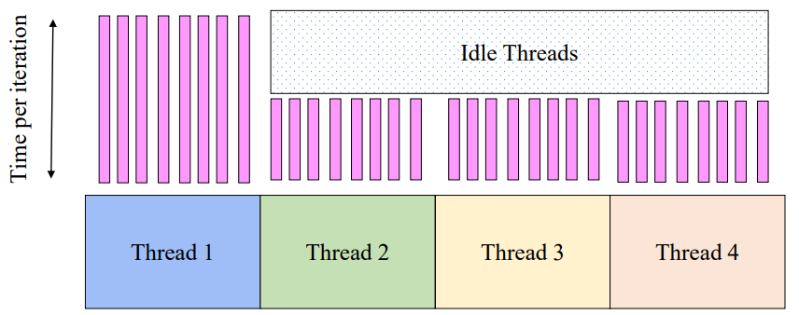
OpenMP: Problem with Static Scheduling
What happens if loop iterations do not take the same amount of time ?
Load imbalance

Slide 24
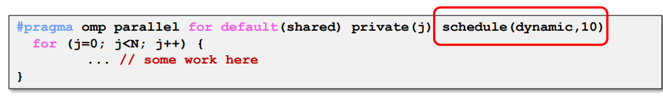
OpenMP: Dynamic Scheduling
Chunks are assigned on the fly, as threads become available
When a thread finishes on chunk, it is assigned another
Caveat: higher overhead than static!

Slide 25
OpenMP: For Scheduling Recap
Scheduling types
Static
- Chunks of specified size assigned round-robin
Dynamic
- Chunks of specified size are assigned when thread finishes previous chunk
Guided
- Like dynamic, but chunks are exponentially decreasing
- Chunk will not be smaller than specified size
Runtime
- Type and chunk determined at runtime via environment variables

Slide 26
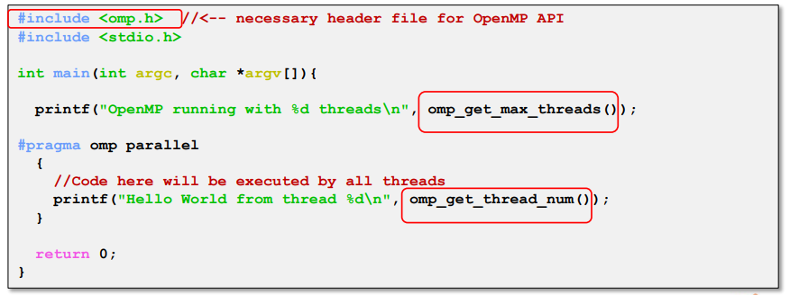
OpenMP: API
API for library calls that perform useful functions
Must include "omp:h"
Will not compile without OpenMP compiler support

Slide 27
OpenMP: API
Sets number of treads used in next parallel section
Overrides OMP_NUM_THREADS environment variable
Positive integer
Returns max possible (generally set by OMP_NUM_THREADS)
Returns number of threads currently in team
Returns thread id of calling thread
Between 0 and omp_get_num_threads-1
Returns number of seconds since some point
Use inpais time=(t2-t1)

Slide 28
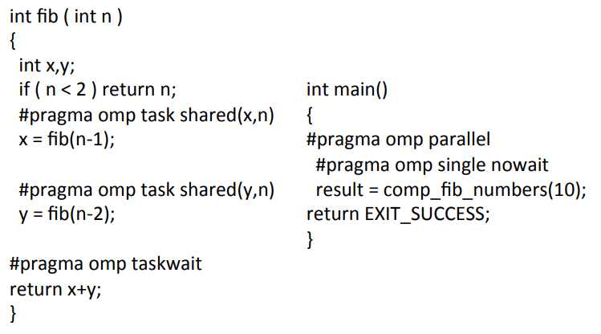
OpenMP: Example Fibonacci

Slide 29
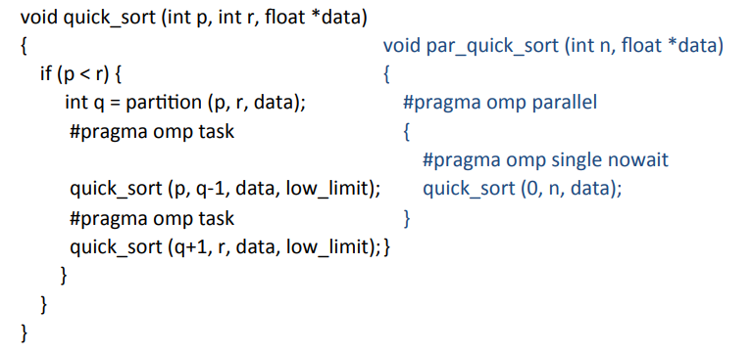
OpenMP: Example Quicksort

Slide 30
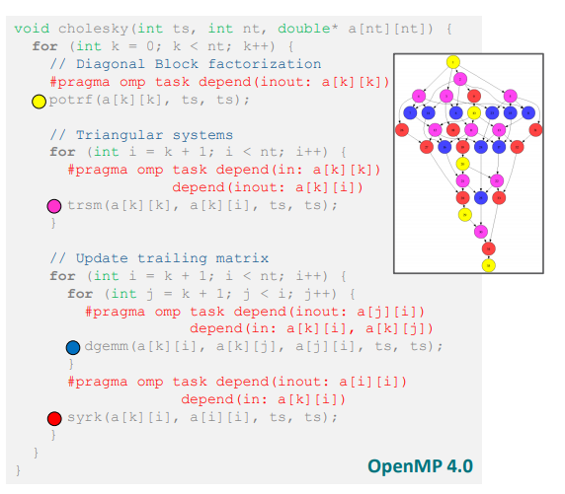
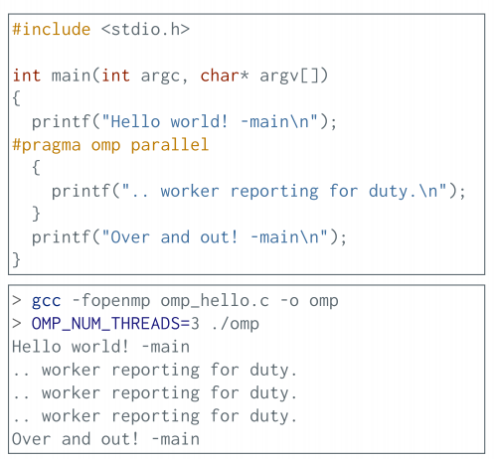
OpenMP: Example Cholesky Factorization

Slide 31
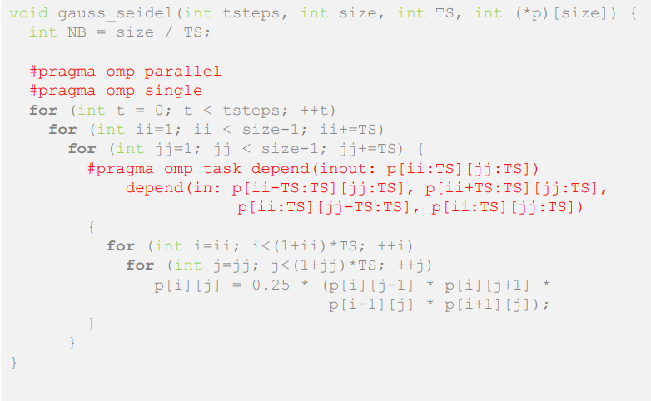
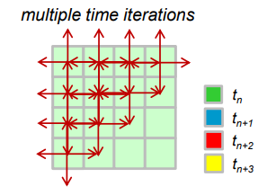
OpenMP: Example Gauss-Seidel
Gauss-Seidel Method is used to solve the linear system Equations. It is a method of iteration for solving n linear equation Ax=b with the unknown variables.

Slide 32
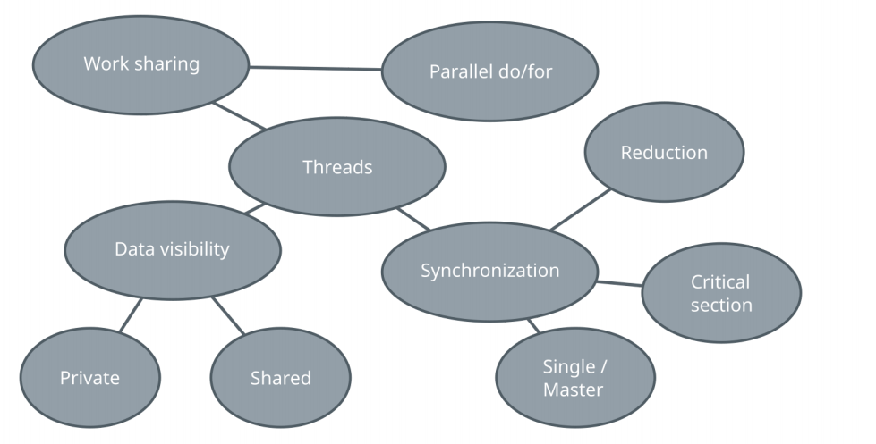
OpenMP: Summary

Slide 33
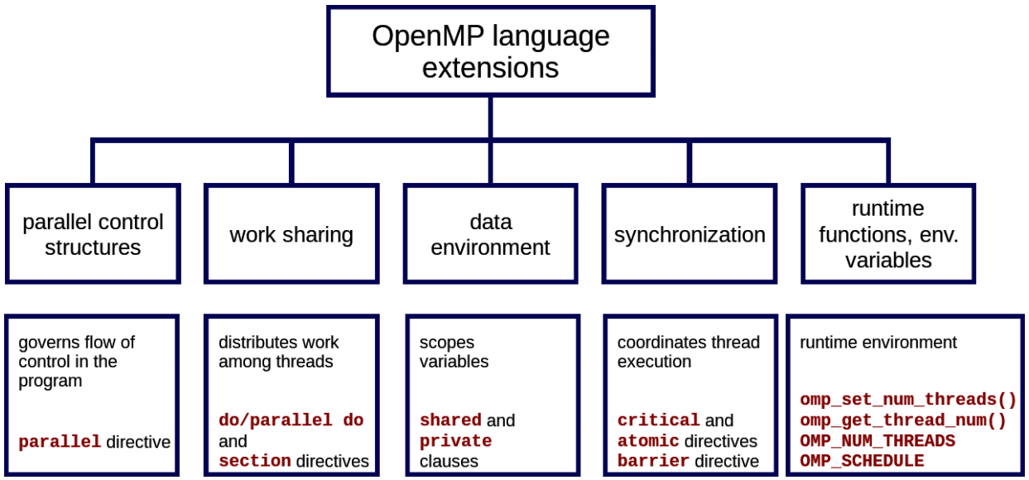
OpenMP: Summary Overview

Slide 34
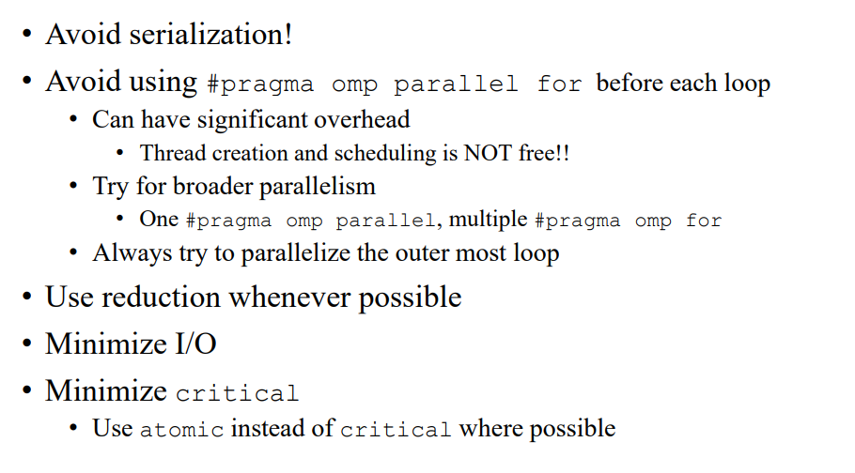

OpenMP: Performance Tips

Slide 35

Thank you for your attention !

